Slide 1



Membership Transformation Project
Data-Driven Insights and
Recommendations
Amrita Jena Chih Hui Wang

Slide 2



Who we are
Heritage New Zealand Pouhere Taonga is an autonomous Crown Entity dedicated to preserving and promoting New Zealand's cultural heritage. Supported by the Government through the Ministry for Culture and Heritage, our mission is to ensure that New Zealand’s bicultural history is understood and valued by all.
Vision: "Honouring the past; Inspiring our future."
What we do
Identify
Promote
Protect

Slide 3
Evaluating Member Benefits
Pricing Strategy Insights
Understanding Membership Category
Assessing the Value and Impact of Current Member Benefits
Developing Insights for Optimized Membership Pricing Strategy
Analysing Membership Categories to Enhance Segmentation
Activities Experience
Evaluating and Enhancing Member Activities Engagement
Improve Our
Current Membership
Plan

Slide 4
Data Overview
 | Focus Group Dataset | Survey Dataset
Data Format / Type | Video / Audio / Text | Categorical / Numeric / Text
Data Size | 3 session x 1 hour 15,107 words | 435 obs. of 48 variables
Data Source | Insights from an in-depth interview with some specific members | Responses from a survey distributed to all members.
Content | Personal motivations and perspectives on the organisation and its benefits. | Feedback on benefits, activity participation, satisfaction, and pricing preferences.

Slide 5
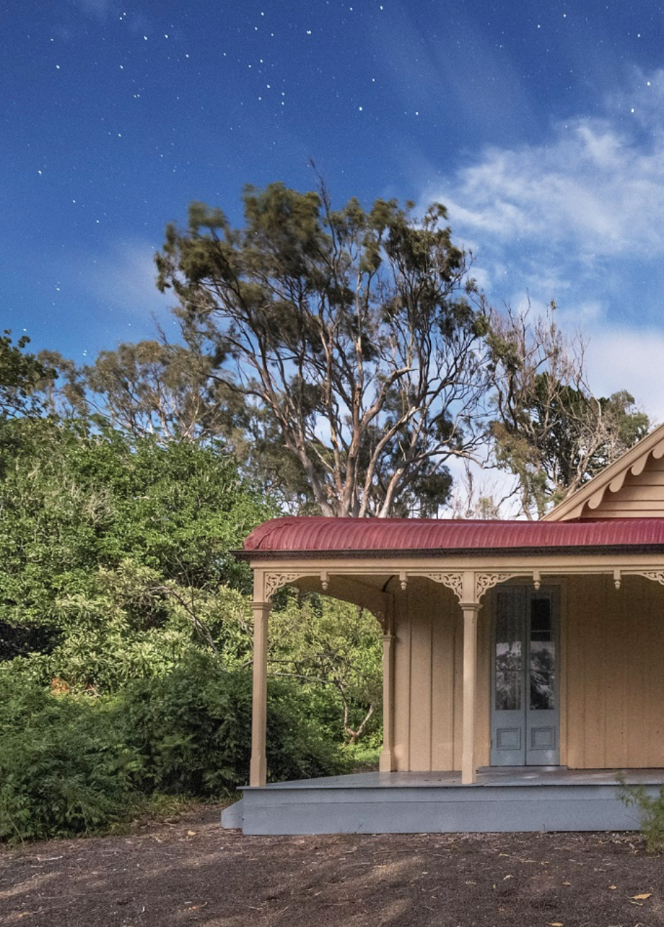
What We've Achieved: Our Contribution

Slide 6
From Data to Insight: Our Journey
Membership
Type
Current
Benefits
Missing Benefits
Satisfaction
NPS
Price
Activities Participate
Magazine Analysis

Slide 7
Membership Types & Pricing for New Zealand Residents
Membership Type | Price
Family (two adults at same address, including any school-age children) | $79
Individual | $69
Joint Senior Citizen (retired, 65 years or over, plus one other person at same address) | $60
Senior Citizen (retired person 65 years or over) | $50
Student (full time) | $50
Life | $1050
Joint Life: (two adults at same address) | $1399
The price is for one year, excluding life members.

Slide 8
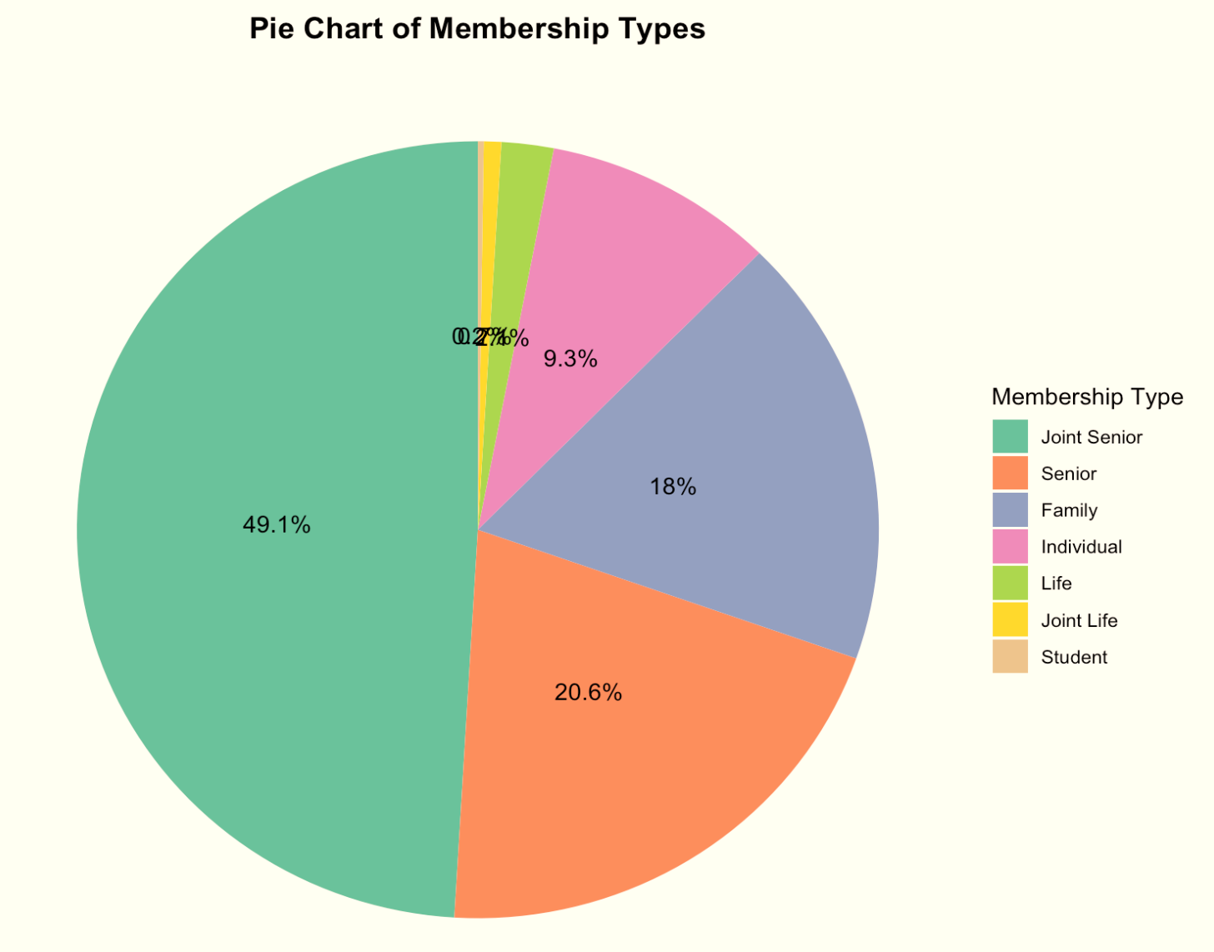
Current Membership Composition
Type | Proportion
Joint Senior | 49.1%
Senior | 20.6%
Family | 18.0%
Individual | 9.3%
Life | 2.1%
Joint Life | 0.7%
Student | 0.2%

Slide 9
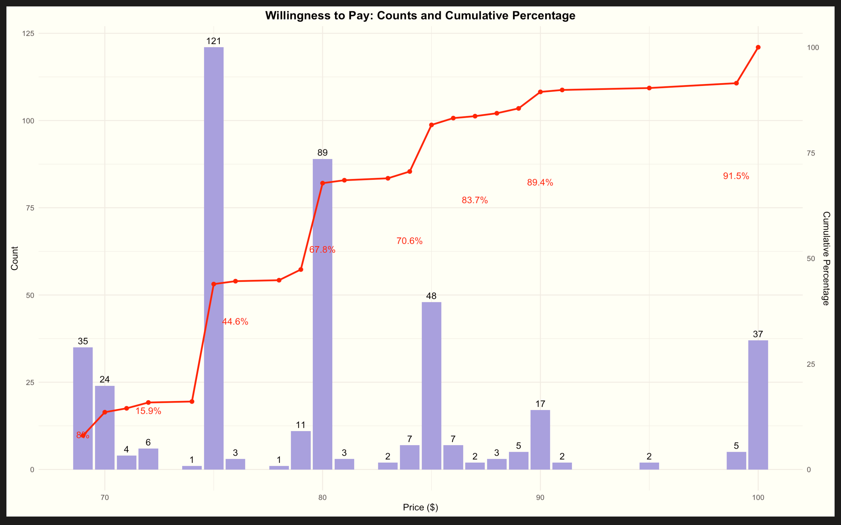
Willingness to Pay for Membership
Accumulated line
$ 75
Price Range:
NZ $69 - $100
$ 80
$ 85
$ 100

Slide 10
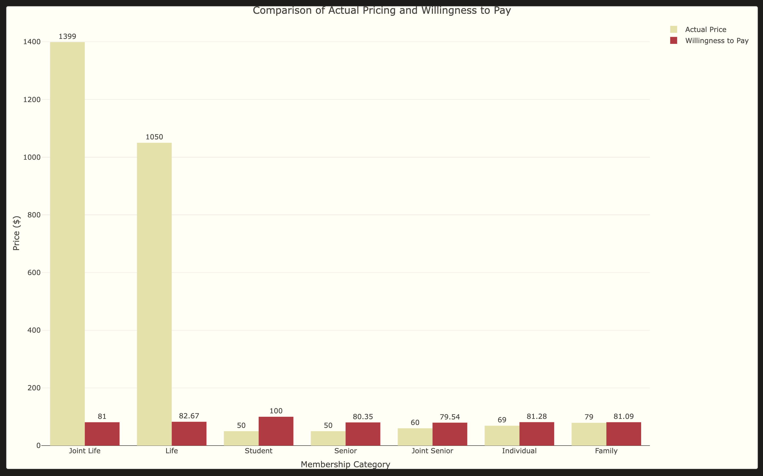
Actual Pricing vs. Willingness to Pay
Note:
When life members choose a price, they are restricted to $69 and $100. Therefore, there is a significant gap between the price of life membership and the price they are willing to pay.

Slide 11
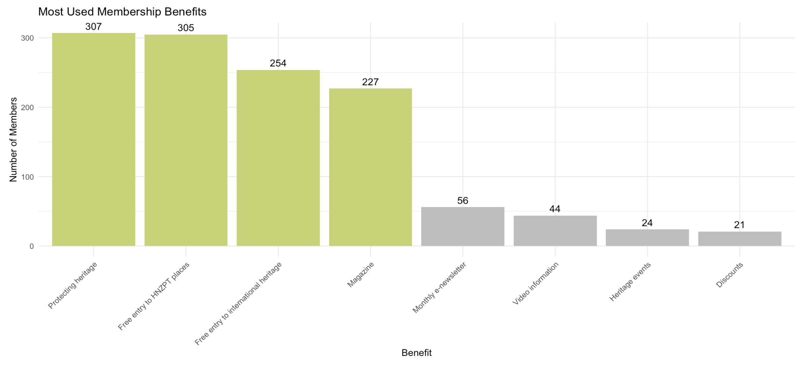
Which Benefits Do You Enjoy Or Use the Most?
Top Four:
Protecting Heritage
Free Entry to HNZPT Places
Free Entry to International Heritage
Magazine

Slide 12
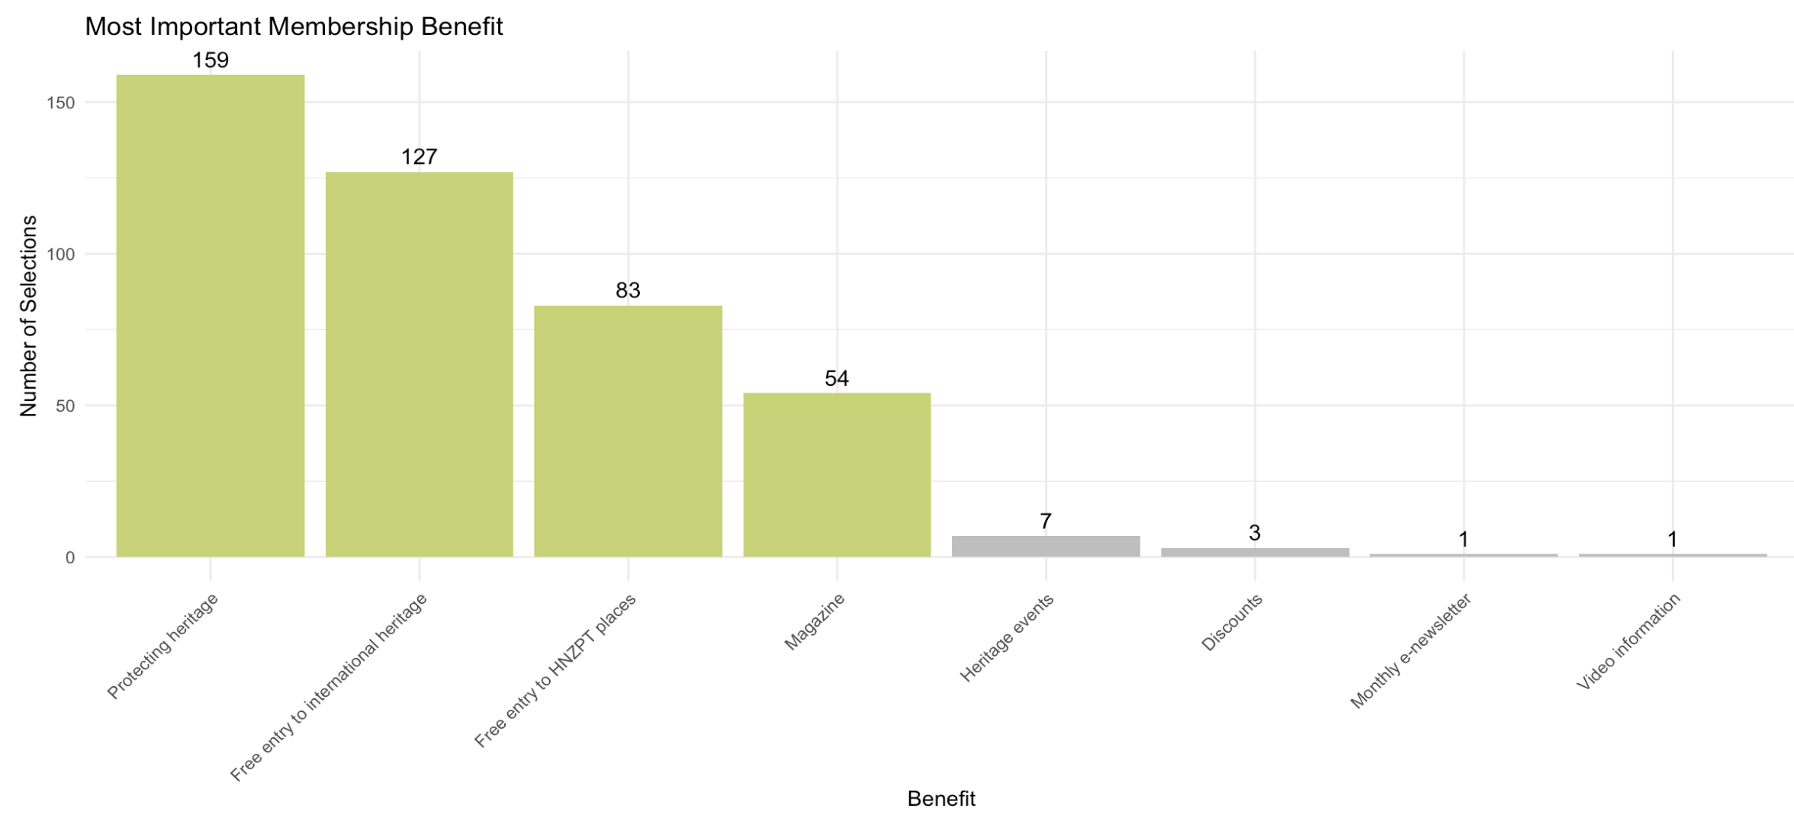
Select Your Most Important Benefit
Top Four:
Protecting Heritage
Free Entry to International Heritage
Free Entry to HNZPT Places
Magazine
This chart provides a general overview of overall benefits enjoyed but does not differentiate preferences across different membership types.
Notes:
Need to explain here, otherwise ppl will get confused by previous one

Slide 13
Correspondence Analysis
Correspondence analysis (CA) is a statistical technique that helps to identify and display the relationships between categorical variables in a dataset. Why Did We Use CA?
Our project involves a lot of categorical variables, and CA allowed us to explore the relationships between different categories, revealing which categories are similar or associated.
By reducing the data to a lower dimension, CA provided us with a clear, visual representation of the associations, making complex relationships easy to interpret.
Notes:
Need to add explanation and highlight point

Slide 14
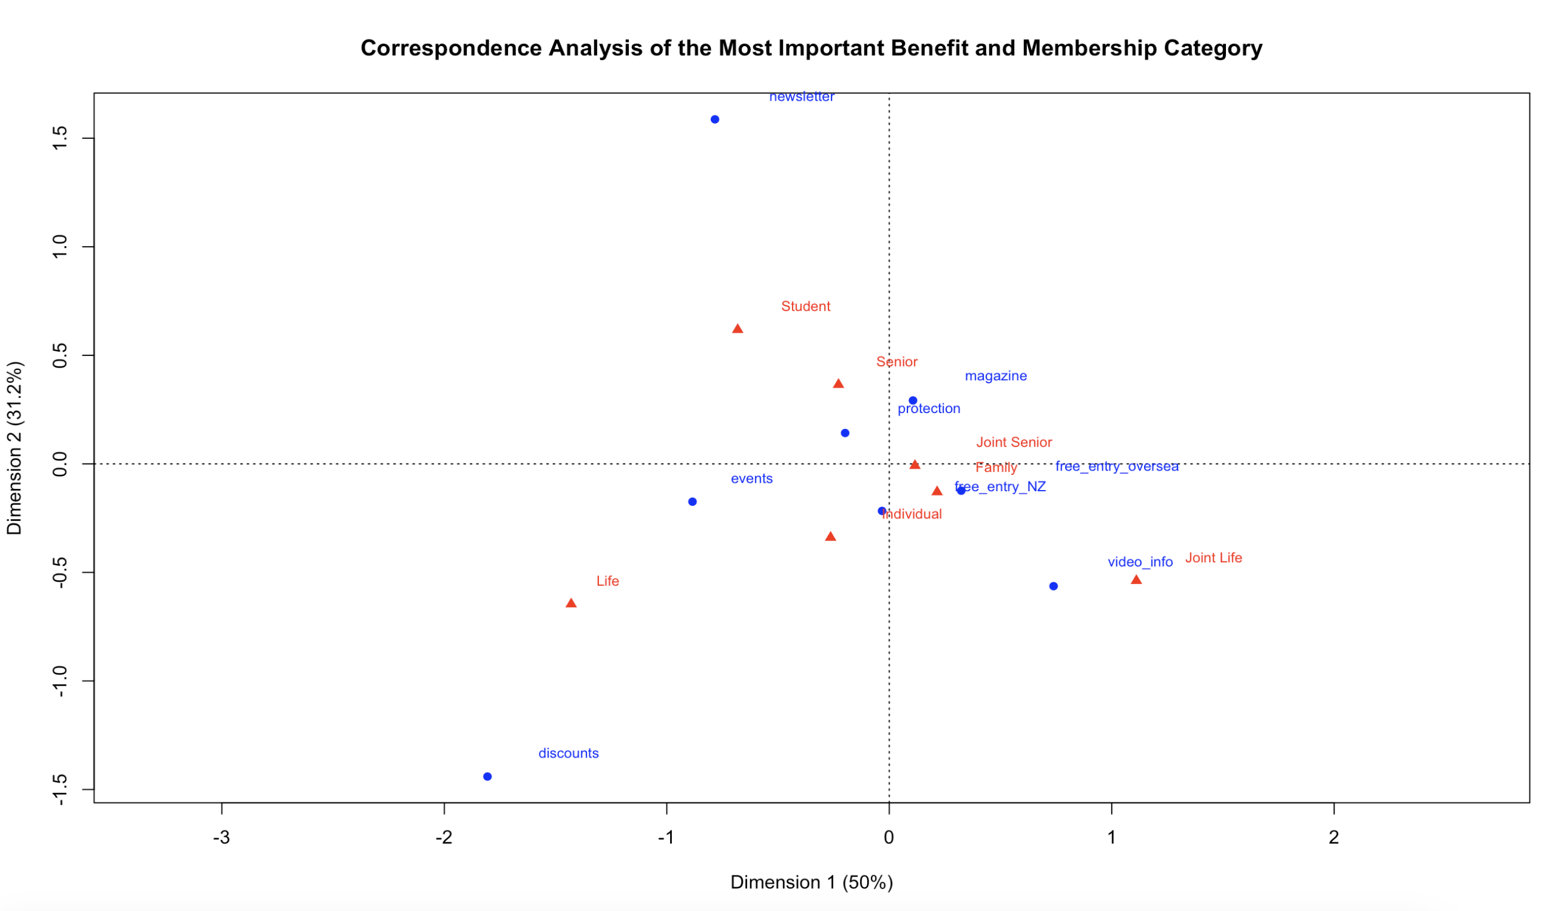
Joint Seniors and Seniors categories to protection and magazine indicates a high level of engagement with these benefits.
Joint Senior and Family categories show a high level of engagement with the benefits of free_entry_oversea heritage sites, indicating strong interest.

Slide 15
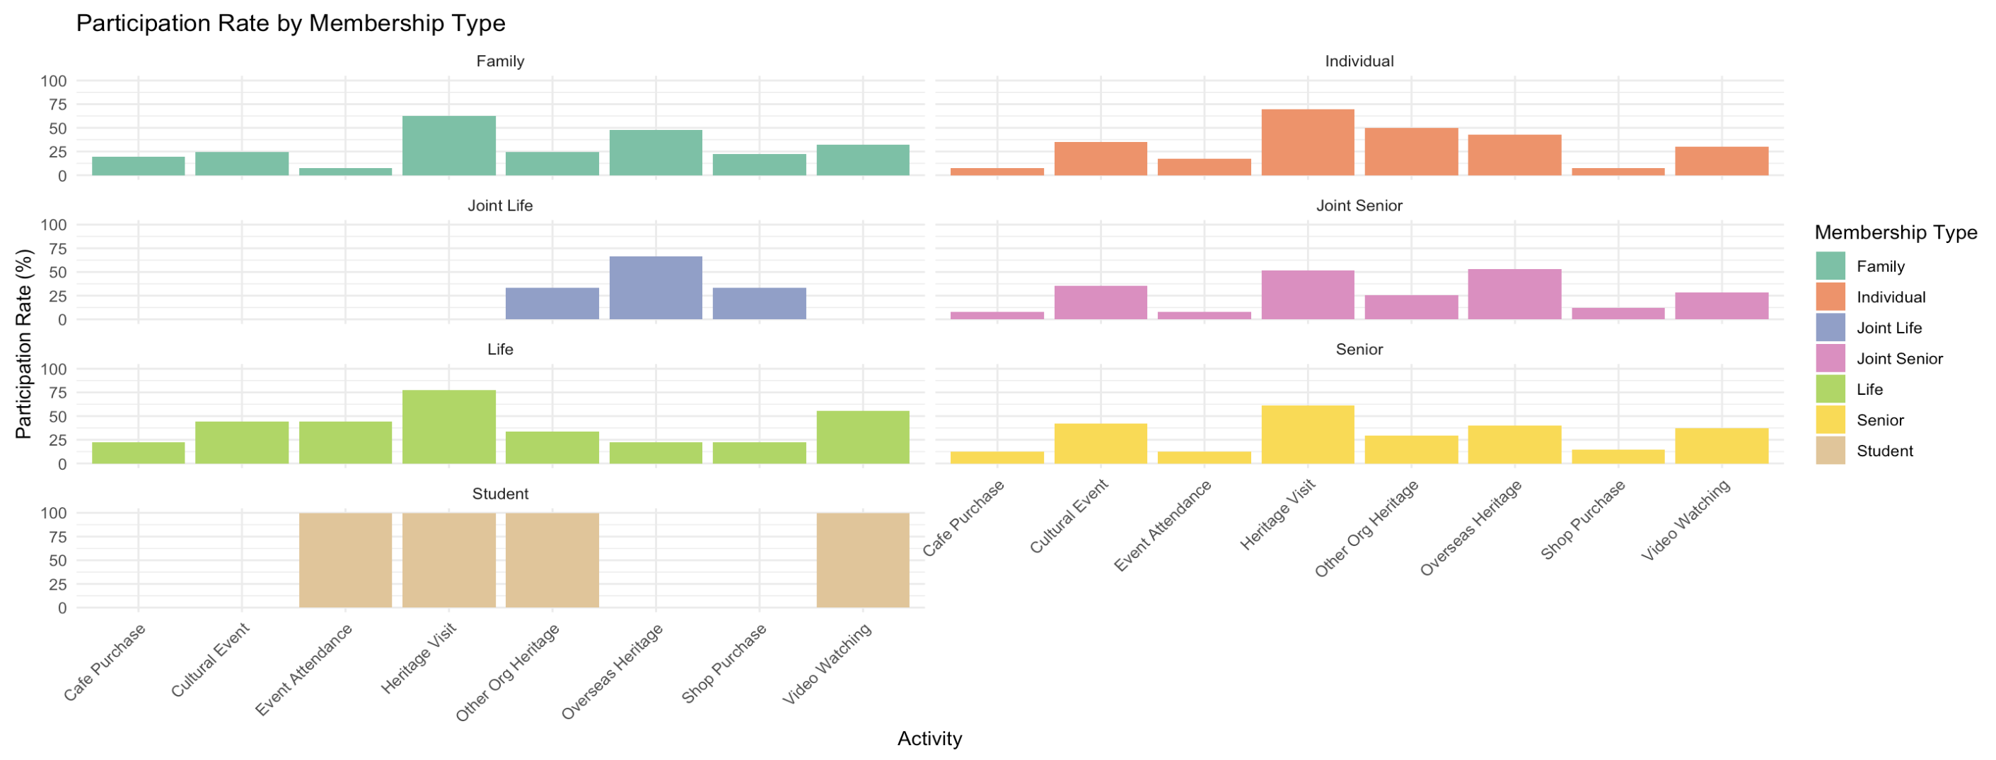
Which Activities Have You Done Within The Last Year?
Notes:
Need to add explanation and highlight point

Slide 16
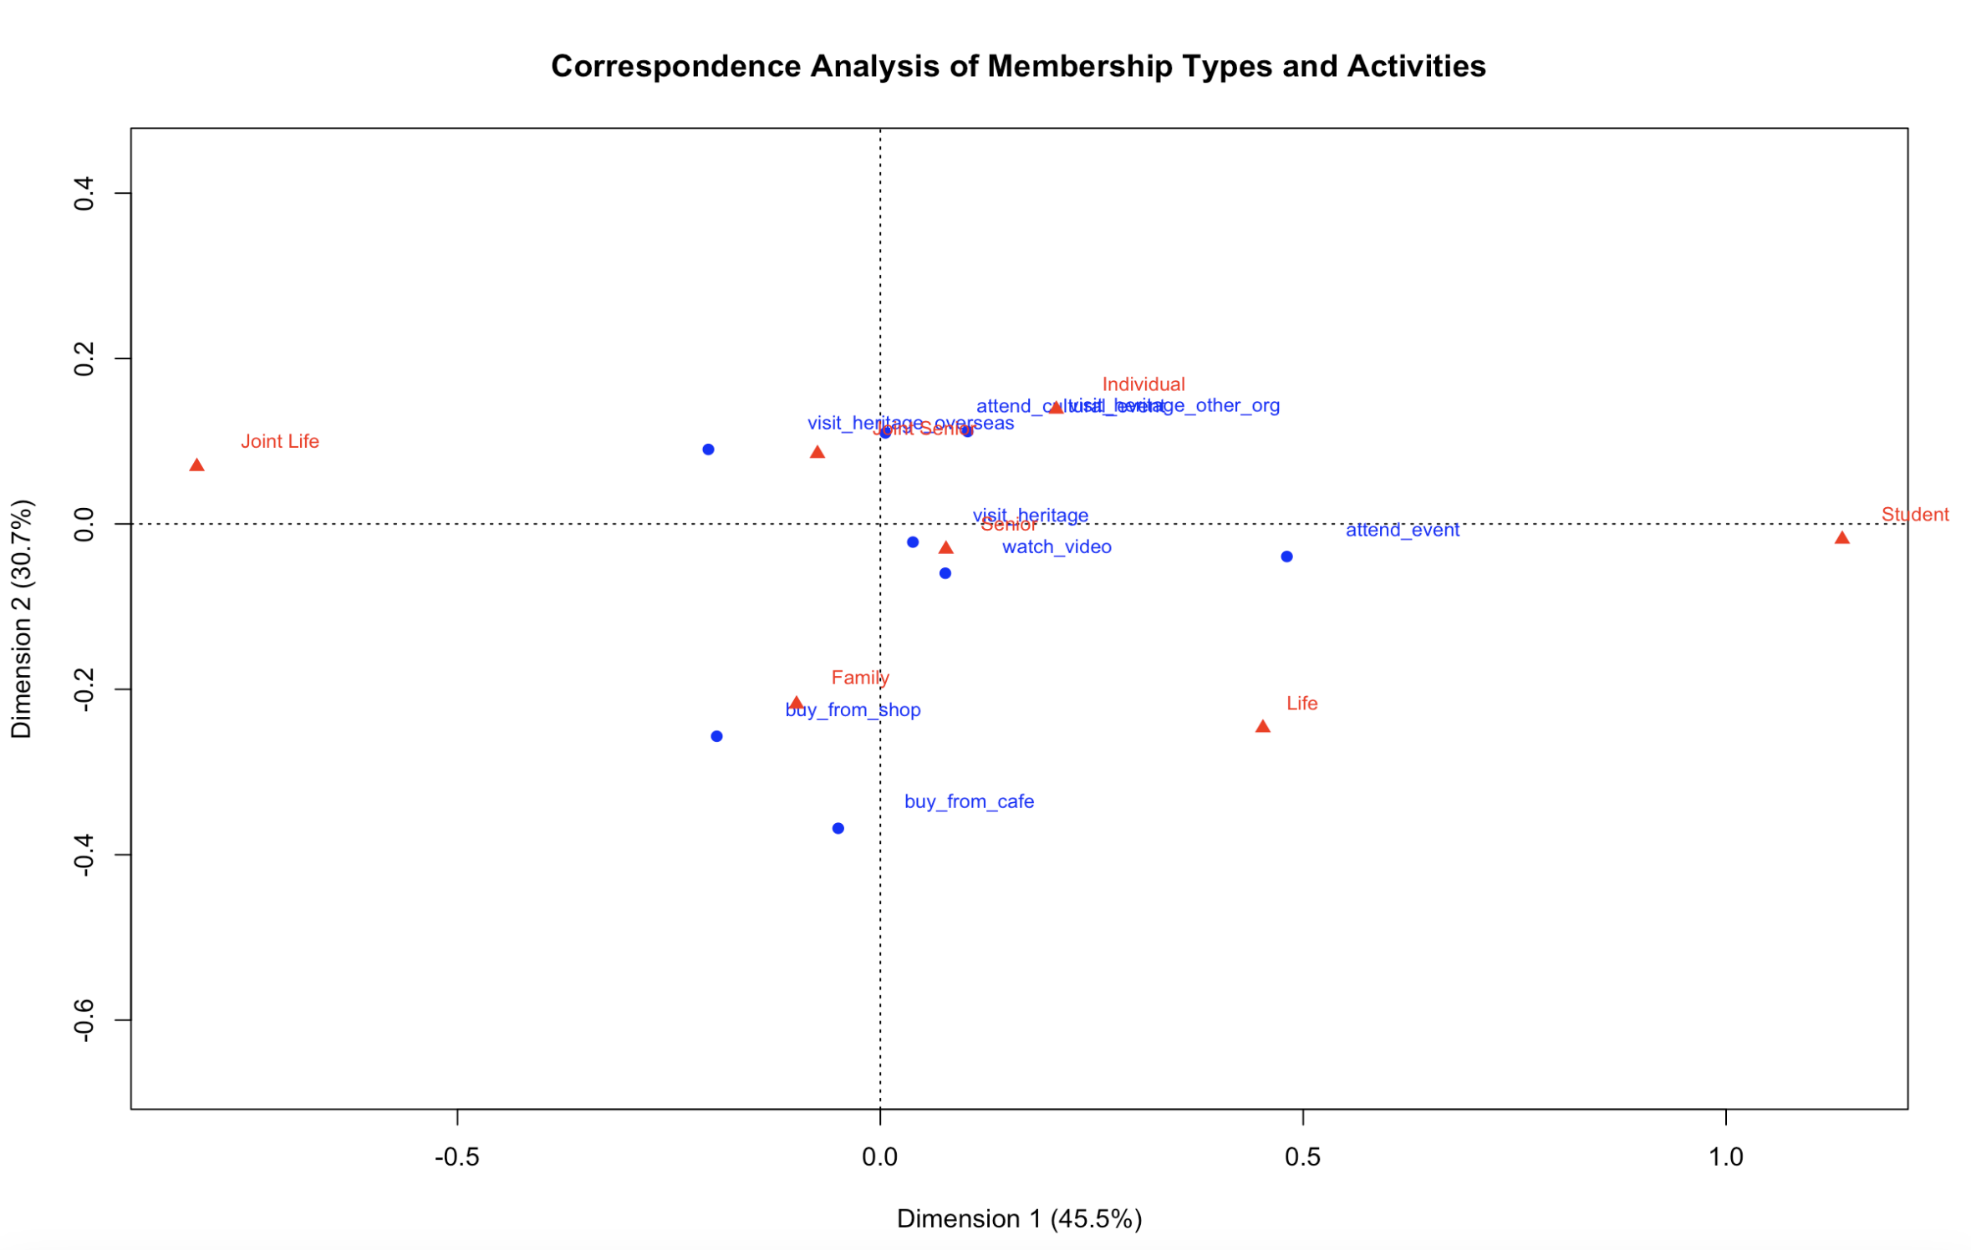
Joint Seniors and Individuals categories to Attend a cultural event and Visit other org heritage indicates a high level of engagement with these activities.
Joint Seniors being close to Visit overseas heritage.
Senior is close to both Visit Heritage and Watch the video.
Notes:
Need to add explanation and highlight point

Slide 17
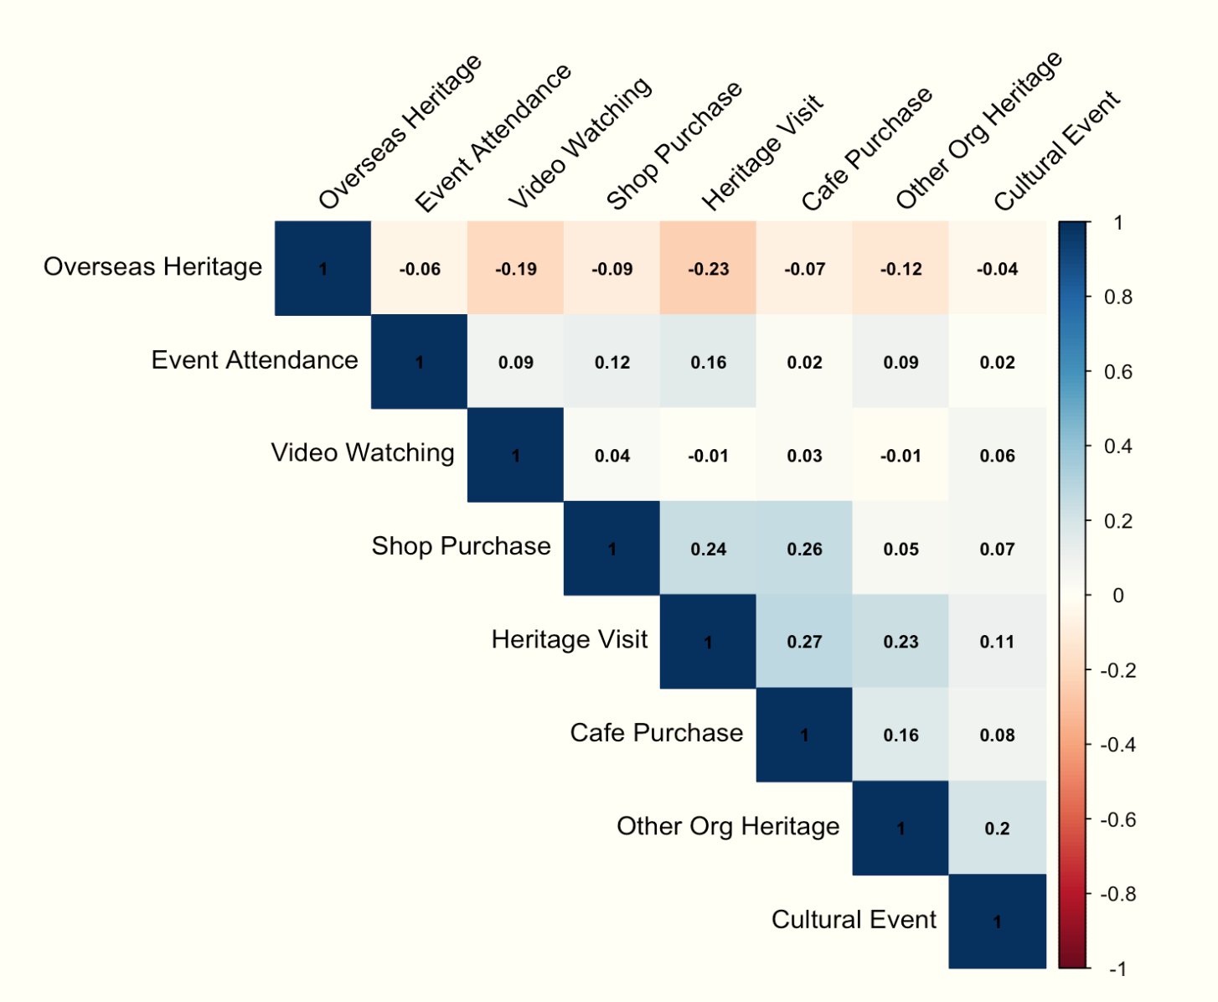
Correlation Between Activities
Correlation Coefficient Range | Correlation Strength
1.0 | Perfect Positive Correlation
0.5 to 1.0 | Strong Positive Correlation
0.1 to 0.5 | Weak Positive Correlation
0.0 | No Correlation
-0.1 to -0.5 | Weak Negative Correlation
-0.5 to -1.0 | Strong Negative Correlation
-1.0 | Perfect Negative Correlation
Notes:
Need to add explanation and highlight point

Slide 18
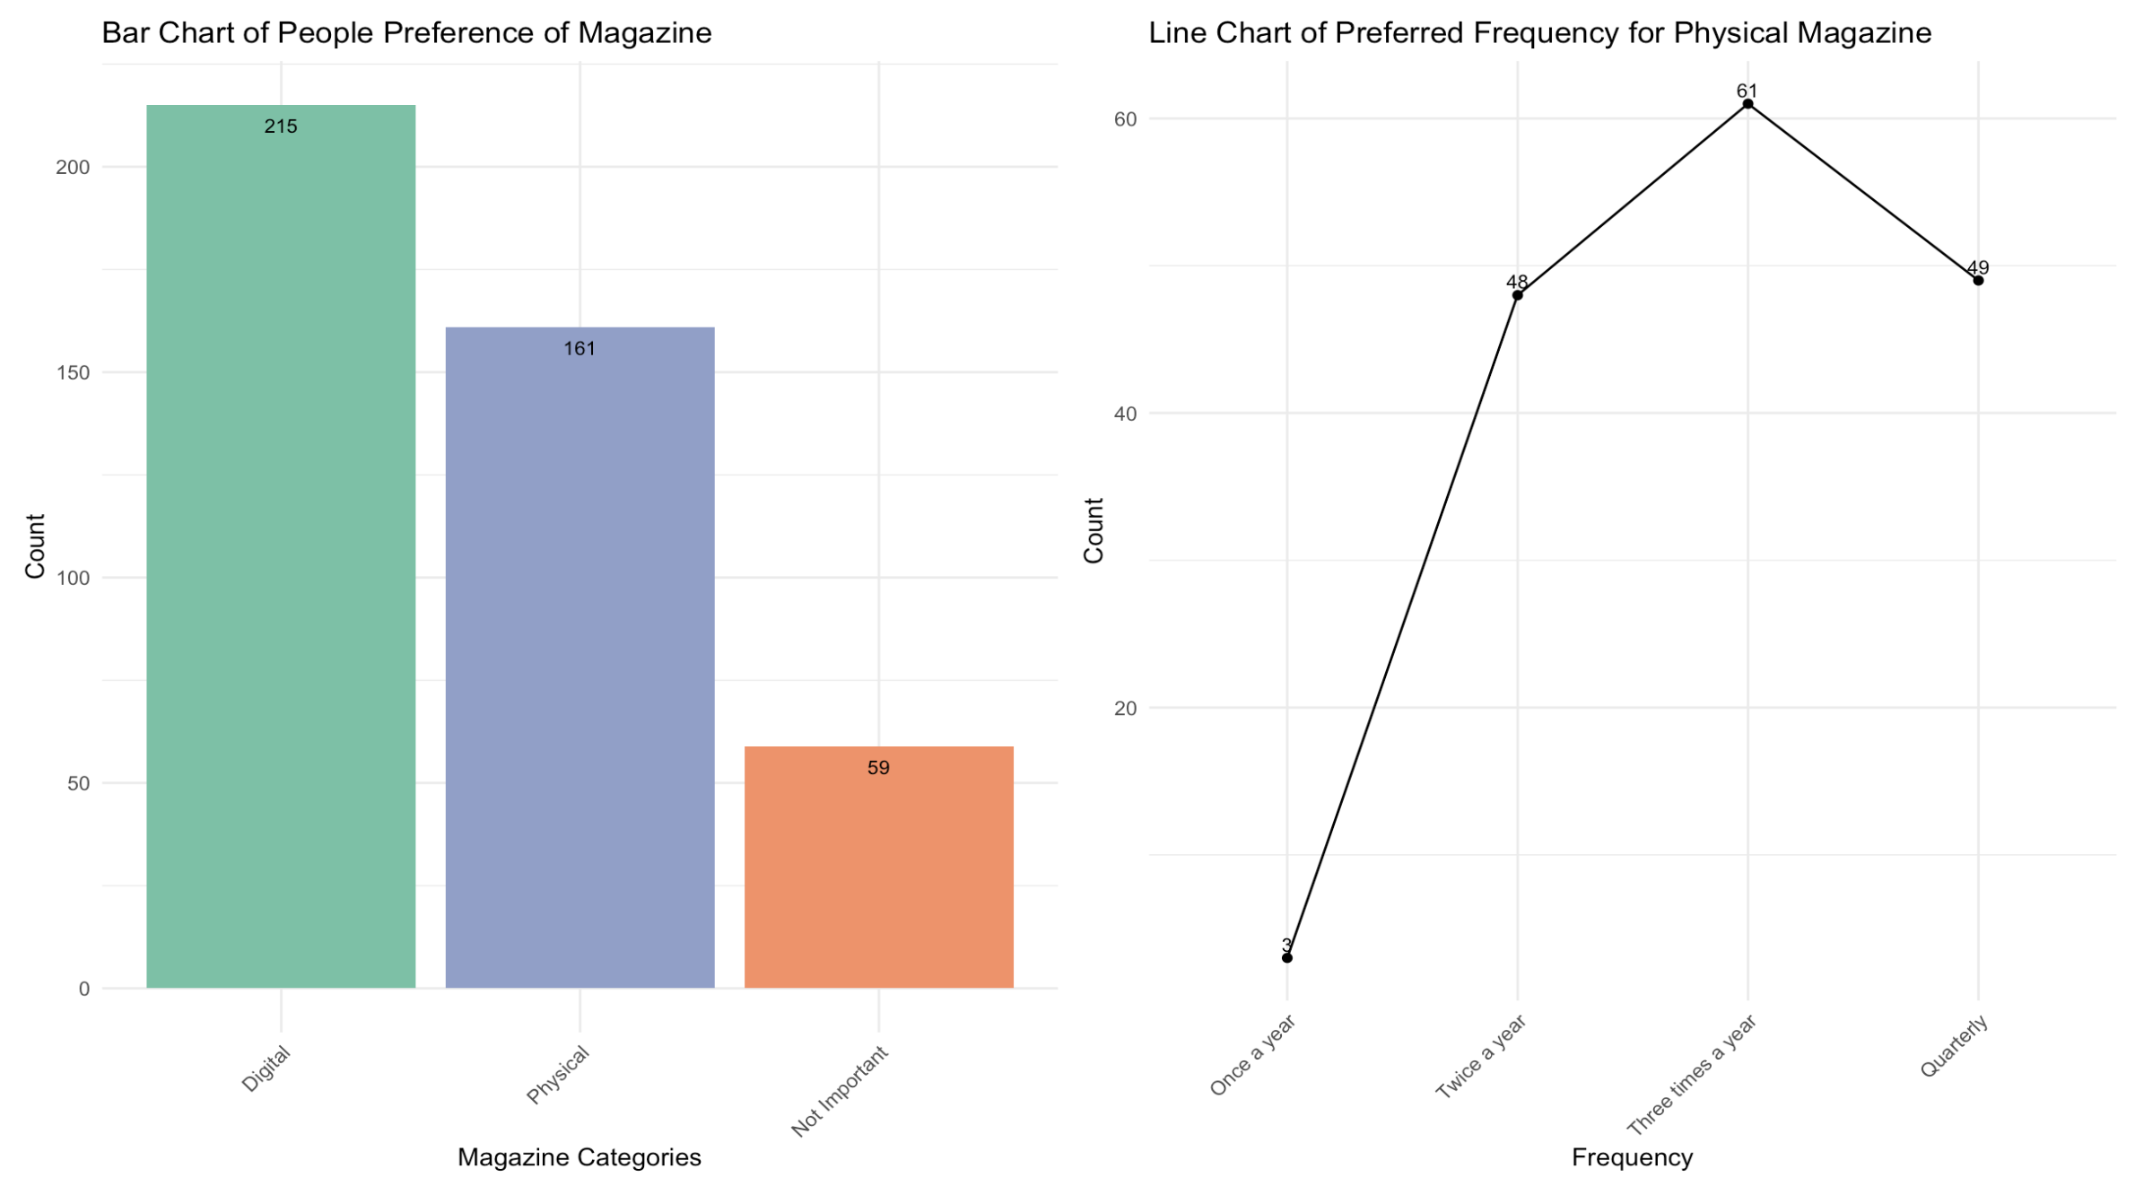
Would You Be Interested In Digital? Physical? Without A Magazine?
How Often Would You Like To Receive A Physical Magazine?
This suggests that a frequency of 3 per year would likely meet the expectations of a majority of our members.
Many people don't mind digital magazines!
Notes:
Need to add explanation and highlight point

Slide 19
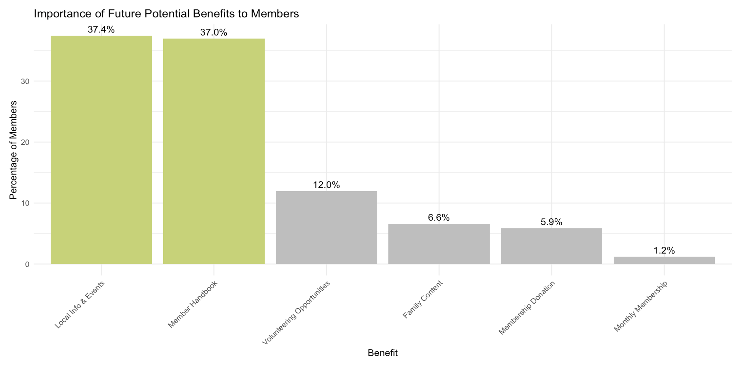
What Benefits Do You Think We Are Missing?
Enhance offerings:
1. Comprehensive resources for members.
2. Information on local activities and events.
Notes:
Need to add explanation and highlight point

Slide 20
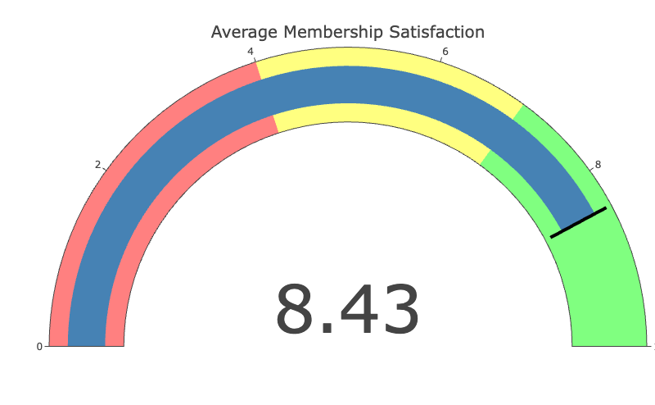
How Satisfied Are You with Your Membership?
5-7: Moderate satisfaction (neutral)
0-4: Low satisfaction
(dissatisfied)
8-10: High satisfaction
(satisfied)
Notes:
Need to modify

Slide 21
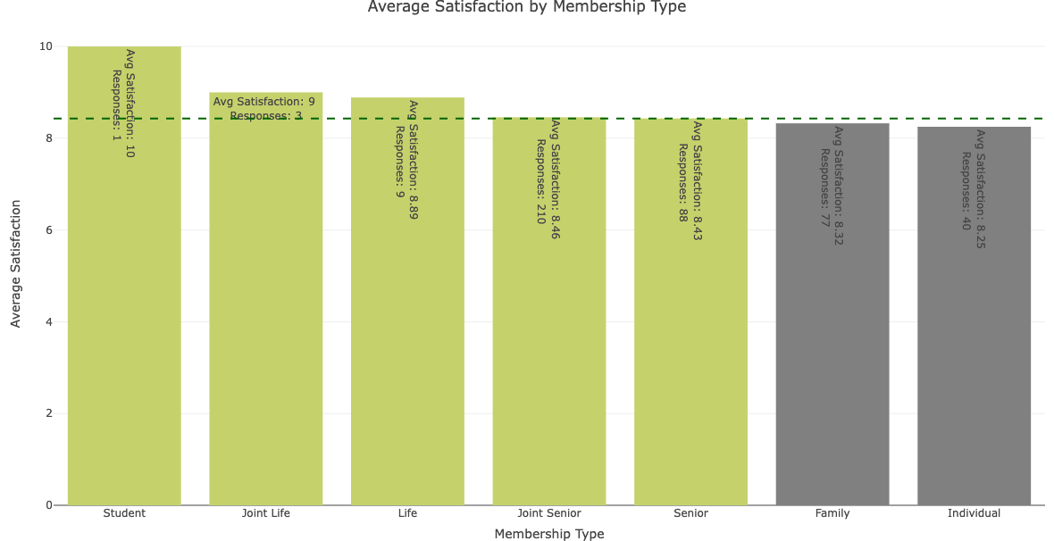
Satisfaction Score By Membership Type
Average Score
8.43

Slide 22
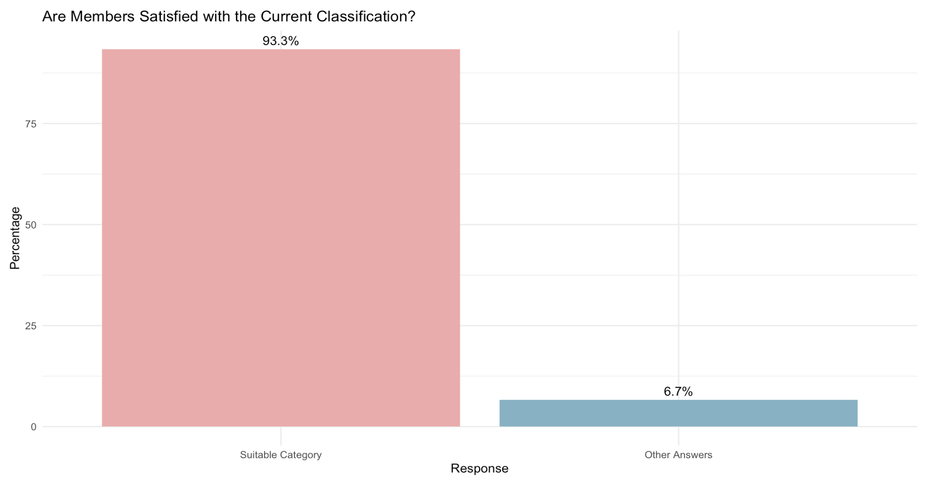
Membership Type Satisfaction
Note:
There may be bias since the respondents are all members. It is reasonable to assume that they have found a membership type that suits them. Those who were unable to find a suitable type may choose not to join.

Slide 23
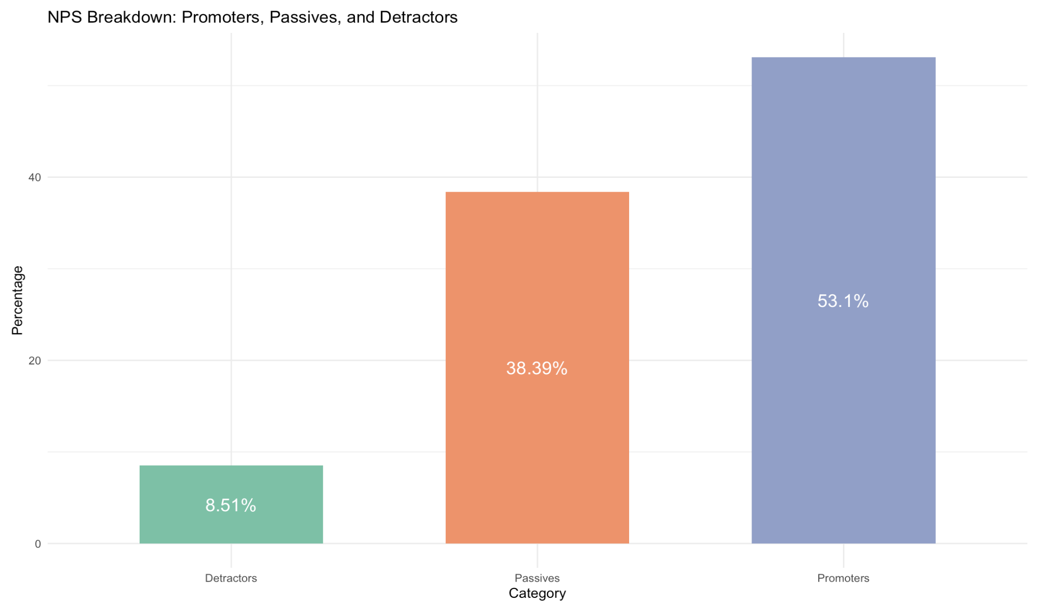
Will You Recommend Membership To Your Friend Or Colleague?
Score Range | Category
0 - 6 | Detractor
7 - 8 | Passive
9 - 10 | Promoter
Net Promoter Score = 44.59
(Promoters – Detractors)
According to SurveyMonkey benchmark data of over 150,000 organisations, the average NPS score is 32, and the top 25% have an NPS score of 72 or higher.

Slide 24
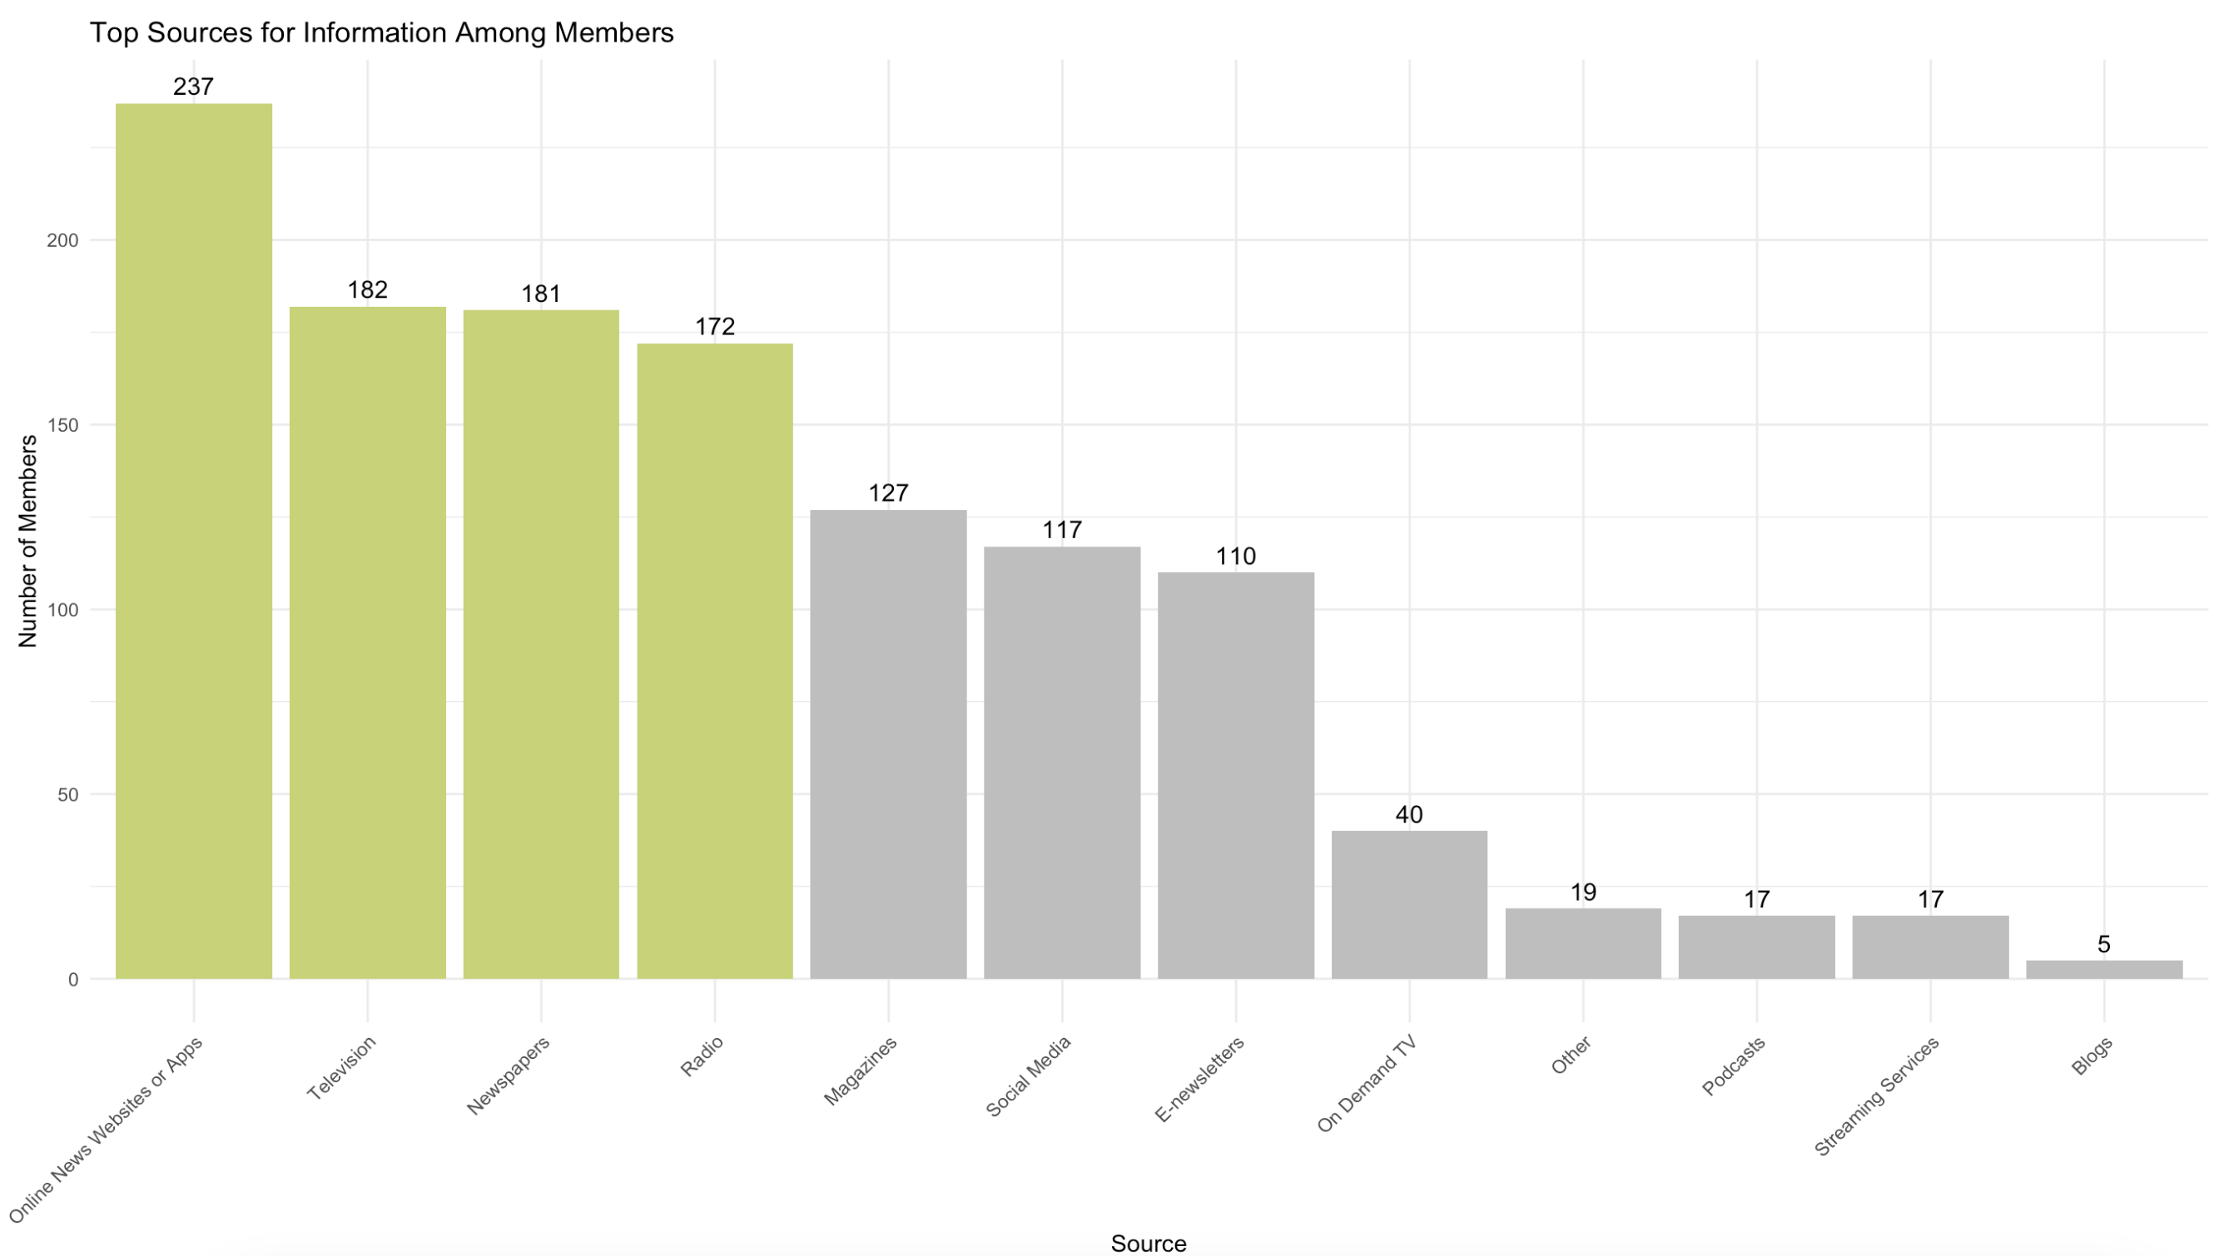
What Sources Do You Rely On For Your News And Information?
Category | Sources
Most Popular | Online (237), Television (182), Newspapers (181), Radio(172)
Moderately Popular | Magazines, Social Media, E-newsletters
Least Used | On-Demand TV, Podcasts, Streaming Services, Blogs
Takeaway | Focus on top sources for effective outreach

Slide 25
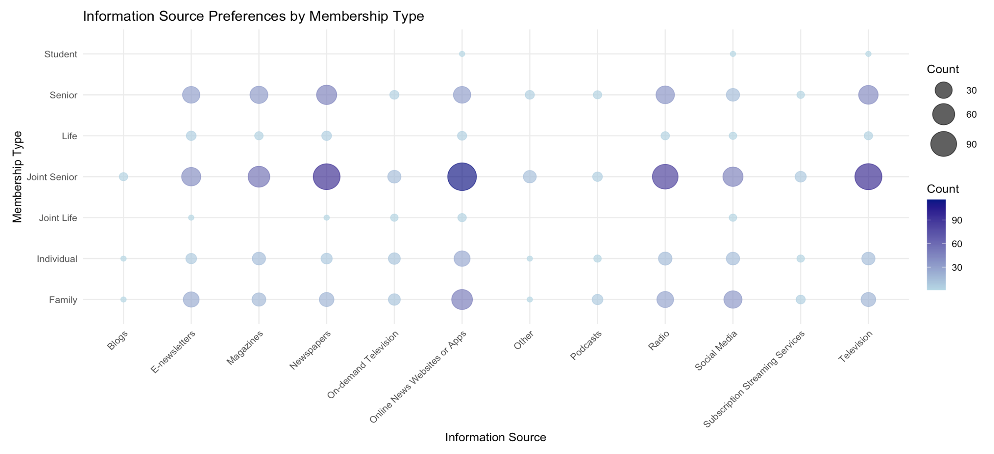
Information Source Preferences By Membership Type
This bubble chart illustrates the preferences of different membership types regarding their preferred methods of receiving messages, helping us better understand member needs.

Slide 26
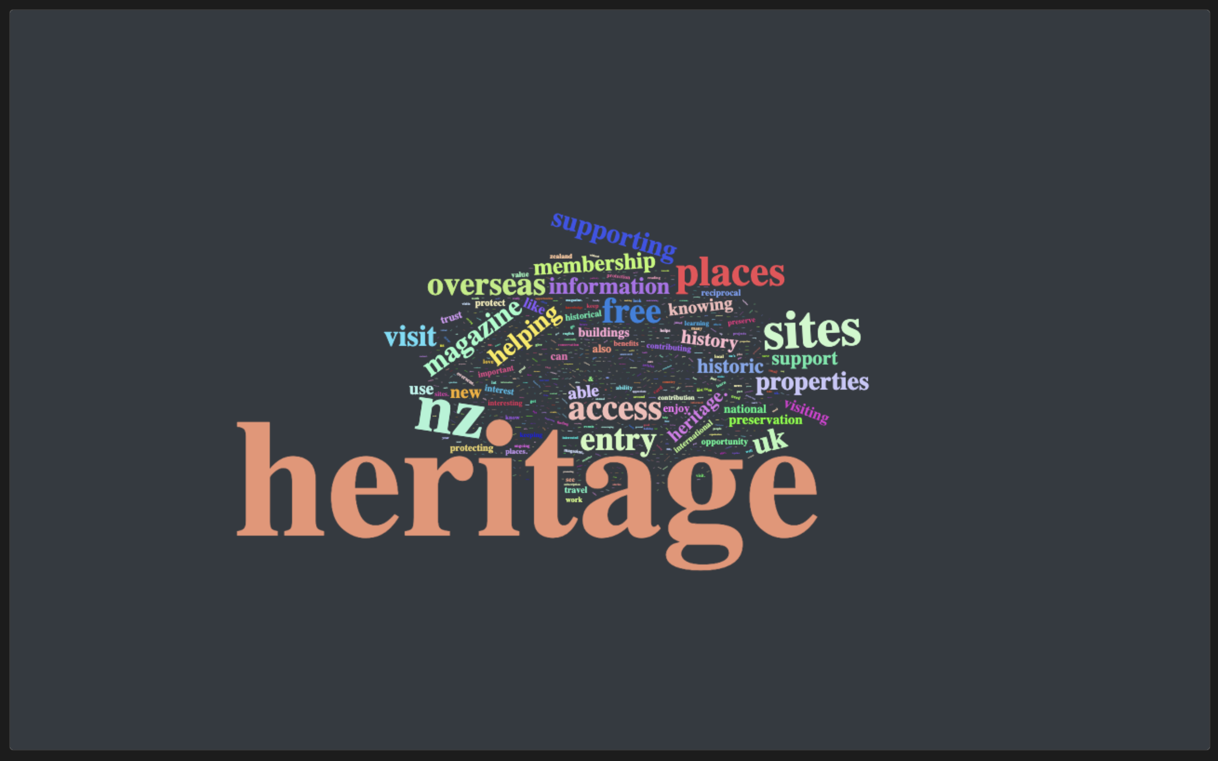
What membership features do you value most for renewal?
Words like "heritage," "sites," "places," and "access" stand out, indicating that respondents frequently mentioned these topics.
This suggests a strong interest in heritage preservation and access to historical sites.

Slide 27
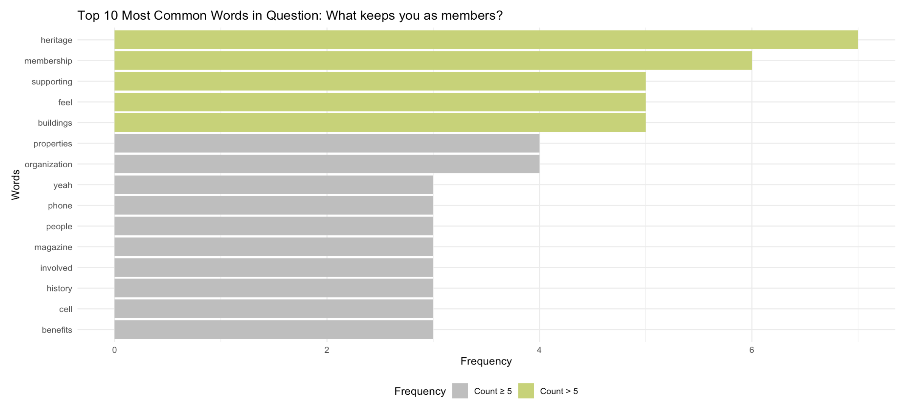
What Keeps You as Member?
(Text Analysis from Focus Group)
We found that “Heritage, Supporting, building, properties, magazine, history” were mentioned multiple times in our responses.
Notes:
Need to add explanation and highlight point

Slide 28

Recommendations
Expand to Other Membership Types: Gather information on their interests in activities to attract new members.
Enhance Loyalty Among Existing Members: Strengthen member loyalty by supplementing existing membership benefits that may be lacking.
Reduce Membership Costs: Consider offering different membership options (with and without magazines) or reduce the frequency of benefits to three times a year.
Notes:
Need to modify

Slide 29
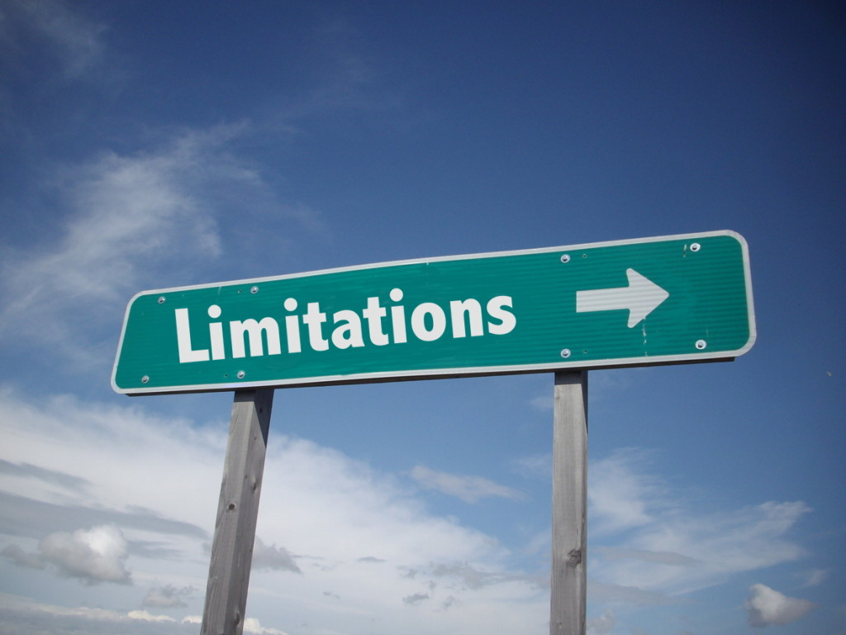
The Limitation of Our Analysis
Uneven Membership Type Distribution
Survey Data Constraints
Focus Group Data Constraints
Categorical Data Challenges
Notes:
Need to modify

Slide 30

Future Step
Conduct a more comprehensive analysis of text data (which may take a significant amount of time).
Design a comprehensive standard membership survey and conduct it regularly. We can use reproducible code to analyse member satisfaction automatically.
Establish an improvement plan: Based on the analysis results, propose specific recommendations and action plans to enhance member satisfaction.

Slide 31

A heartfelt thank you to Brendon and Stephanie for their invaluable support and to Damjan for his guidance throughout our project.

Slide 32


Thank you Feel free to ask any questions!

